Slide 1

Combining Machine Learning, Deep Learning, and Graph-Based Models for Detecting Novel Pathogens
Neha Goud Baddam, Ambrish Kumar

Slide 2
Introduction and Objectives
Global Health Challenge: Rapidly emerging viral pathogens like COVID-19 threaten global health.
Need for Fast Detection: Identifying novel pathogens early is crucial for effective response and containment.
Limitations of Traditional Methods: Existing diagnostic methods often rely on known pathogen databases and struggle with novel or highly mutated viruses.
Project Objective: Leverage simulated Next-Generation Sequencing (NGS) data and advanced computational models (ML, DL, Graph-based) to classify viral sequences as pathogenic or nonpathogenic.
Goal: Enhance real-time pathogen detection systems for early identification of potential threats, supporting global health preparedness.

Slide 3
Relevance to Problem Statement
Rapid Detection of Novel Pathogens
Traditional models rely on known sequences, limiting the detection of new viruses.
The project employs models that recognize sequence patterns, detecting new threats without direct sequence comparison.
Real-Time Pathogen Screening
NGS platforms require fast, accurate classification tools for timely decisions.
This project contributes by developing high-speed, efficient models optimized for real-time applications.
Scalability and Flexibility
The project focuses on scalable models capable of processing large NGS data volumes.
Simulated data enables adaptability, allowing models to be retrained on new pathogens, ensuring long-term utility.

Slide 4
Data
Datasets
The datasets include viral sequences derived from simulated NGS data.
Simulated data mimics real-world sequencing, providing a controlled environment for training and validating models.
File Types
FASTA Files: Representing training, validation and test sets with sequence reads.
Data
pathogenic_val_vir_nano_filtered: Contains pathogenic virus sequences for validation.
nonpathogenic_val_vir_nano_filtered: Includes nonpathogenic virus sequences for validation.
Simulated
NGS Data
DeepSimulator Tool: A tool that generates realistic Nanopore sequencing reads by simulating the sequencing process, including potential errors and sequence-specific characteristics.
Target Read Lengths: Full-length reads for testing (~8kb average) and shorter subreads (~250bp) for training and validation.

Slide 5
Features Extracted for Modeling
k-mer Frequencies (2-mers, 3-mers, 4-mers)
What: These are substrings of length 2, 3, or 4 extracted from the DNA sequence. For example, for k=2, all possible 2-mers are AA, AT, AC, etc. The frequency of each k-mer is recorded.
GC Content
What: The proportion of guanine (G) and cytosine (C) nucleotides in a DNA sequence.
Relevance: k-mers capture local sequence patterns. Pathogens may have distinct sequence motifs due to evolutionary pressures. Certain k-mers might appear more frequently in pathogenic viruses due to their role in virulence factors or replication strategies.
Why Important: Provides an understanding of recurring patterns in DNA sequences, which could relate to the functional or structural properties of the virus genome.
Relevance: GC content can influence the stability of the DNA structure (GC pairs have three hydrogen bonds, making them more stable than AT pairs). Pathogenic viruses may have different GC content compared to non-pathogenic ones due to adaptation to host environments or replication efficiency.
Why Important: High GC content can be associated with more stable genomes or specific genomic regions, potentially affecting the virus's ability to persist or replicate under stress.

Slide 6
Features Extracted for Modeling
AT Content
What: The proportion of adenine (A) and thymine (T) nucleotides in a DNA sequence.
CpG Islands
What: Regions of the DNA where the frequency of the cytosine-guanine (CG) dinucleotide is higher than expected.
Relevance: Complementary to GC content, AT content affects genome structure and function. Regions with high AT content may be more prone to mutations and less stable.
Why Important: Pathogenic viruses may favor certain ratios of AT/GC content to increase or reduce mutation rates depending on their survival strategy.
Relevance: CpG islands are often found near regulatory regions and can affect gene expression. In viral genomes, CpG depletion is linked to immune evasion, as host organisms can recognize CpG-rich regions.
Why Important: Pathogenic viruses may reduce CpG content to evade host immune detection, making this a distinguishing feature.

Slide 7
Features Extracted for Modeling
Shannon Entropy (Sequence Complexity)
What: A measure of how unpredictable or complex a DNA sequence is. Shannon entropy increases with more diverse nucleotide distributions.
Codon Usage Bias
What: The frequency at which different codons (sets of three nucleotides coding for amino acids) are used in a sequence. Different organisms and viruses prefer certain codons over others.
Relevance: More complex sequences (higher entropy) might indicate regions under less selective pressure or regions encoding proteins with a broader range of functions. Low entropy sequences might indicate conserved regions critical for survival.
Why Important: Differences in sequence complexity may reveal evolutionary strategies of pathogens to balance mutation rates and conserve essential functions.
Relevance: Viruses that infect specific hosts may evolve to match the codon usage patterns of their hosts to optimize protein synthesis. Pathogenic viruses might show a stronger codon usage bias to enhance their fitness within the host.
Why Important: Reflects viral adaptation to host environments, which is important for understanding viral efficiency and pathogenic potential.

Slide 8
Features Extracted for Modeling
GC Skew
What: The asymmetry between guanine (G) and cytosine (C) content in a sequence, calculated as (G - C) / (G + C).
Melting Temperature (Tm)
What: The temperature at which the DNA double helix denatures and becomes single-stranded.
Relevance: GC skew can provide insights into the replication and transcriptional orientation of genomes. It is often observed in organisms where replication machinery favors one strand, which can be linked to evolutionary pressures.
Why Important: In viruses, GC skew might indicate biased mutation or replication patterns, potentially differentiating pathogenic sequences that undergo rapid replication from those that don't.
Relevance: GC-rich sequences have a higher melting temperature because GC pairs form stronger bonds (three hydrogen bonds) compared to AT pairs. Viral genomes with high melting temperatures might be more stable under hostile conditions (e.g., during host immune responses).
Why Important: Provides information about the stability of the viral genome, which can correlate with pathogenicity (e.g., stability under heat or during replication).

Slide 9
Features Extracted for Modeling
k-mer Diversity (Diversity Index)
What: Measures how diverse the k-mers are in the sequence. Calculated as the ratio of unique k-mers to the total number of k-mers in the sequence.
Dinucleotide Frequencies
What: The frequency of all possible two-nucleotide combinations (e.g., AA, AT, CG, etc.).
Relevance: A higher k-mer diversity suggests a more varied sequence, which might indicate regions of the genome that are more prone to mutations or recombination. A lower diversity could indicate conserved, functionally important regions.
Why Important: Pathogens may have certain regions with low diversity (conserved genes essential for infection) and others with high diversity (regions for immune evasion).
Relevance: Certain dinucleotides, like CpG, can have biological significance, such as influencing gene expression or being recognized by host defense mechanisms. Dinucleotide biases can be a sign of evolutionary pressures acting on the viral genome.
Why Important: Can capture subtle sequence patterns that are relevant for viral replication or immune evasion, especially in distinguishing pathogenic from non-pathogenic viruses.

Slide 10
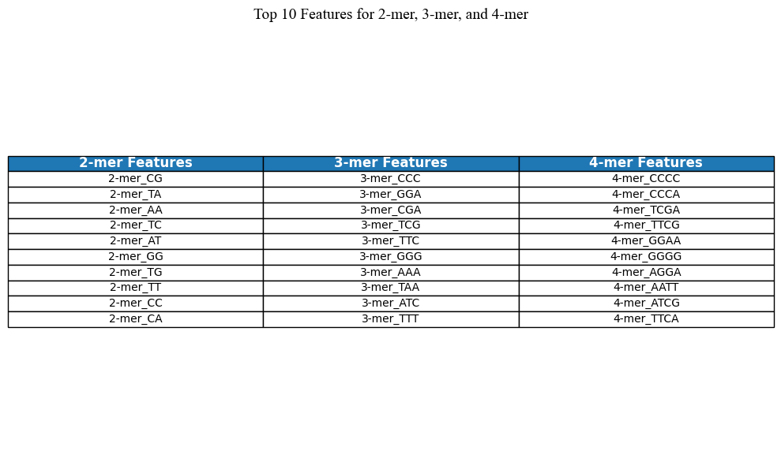
Features Extracted for Modeling (Example)

Slide 11
Model Architectures
Machine Learning Models
Random Forest: Known for handling high-dimensional data and providing feature-importance insights.
XGBoost: Capable of achieving high accuracy by focusing on misclassified samples and iteratively refining the model. XGBoost’s flexibility and scalability make it a strong choice for large-scale genomic datasets.
Deep Learning Models
Applied due to their capability to recognize spatial dependencies within sequence patterns.
Layers of convolutional filters capture sequential dependencies, which are flattened and passed through fully connected layers for final classification.
Graph-Based Models
Sequences are represented as nodes in a graph, with edges representing relationships between sequences.
Allows for relational data capture, which may reveal insights into pathogenicity based on how similar or connected a sequence is to known pathogens.
Binary Prediction Task
All models are trained to classify input sequences as either pathogenic or nonpathogenic, using binary cross-entropy loss for optimization in the case of DL models.
We utilize NN and CNN
We utilize GCN

Slide 12
Feature Importance Analysis
Feature Selection and Importance
By leveraging the inherent feature importance capabilities of tree-based algorithms (e.g., Random Forest, XGBoost), important features are identified for the task.
Key Findings
Certain k-mer patterns, especially 3-mers GGc and GGA have strong associations with pathogenicity.
Melting Temperature and GC composition emerge as a consistent indicator, where higher or lower GC content could influence classification outcomes.
Biological Relevance
These findings not only help in refining the model but also provide potential biological insights, linking sequence motifs with pathogenic traits, and offering a pathway to more explainable AI models in virology.

Slide 13
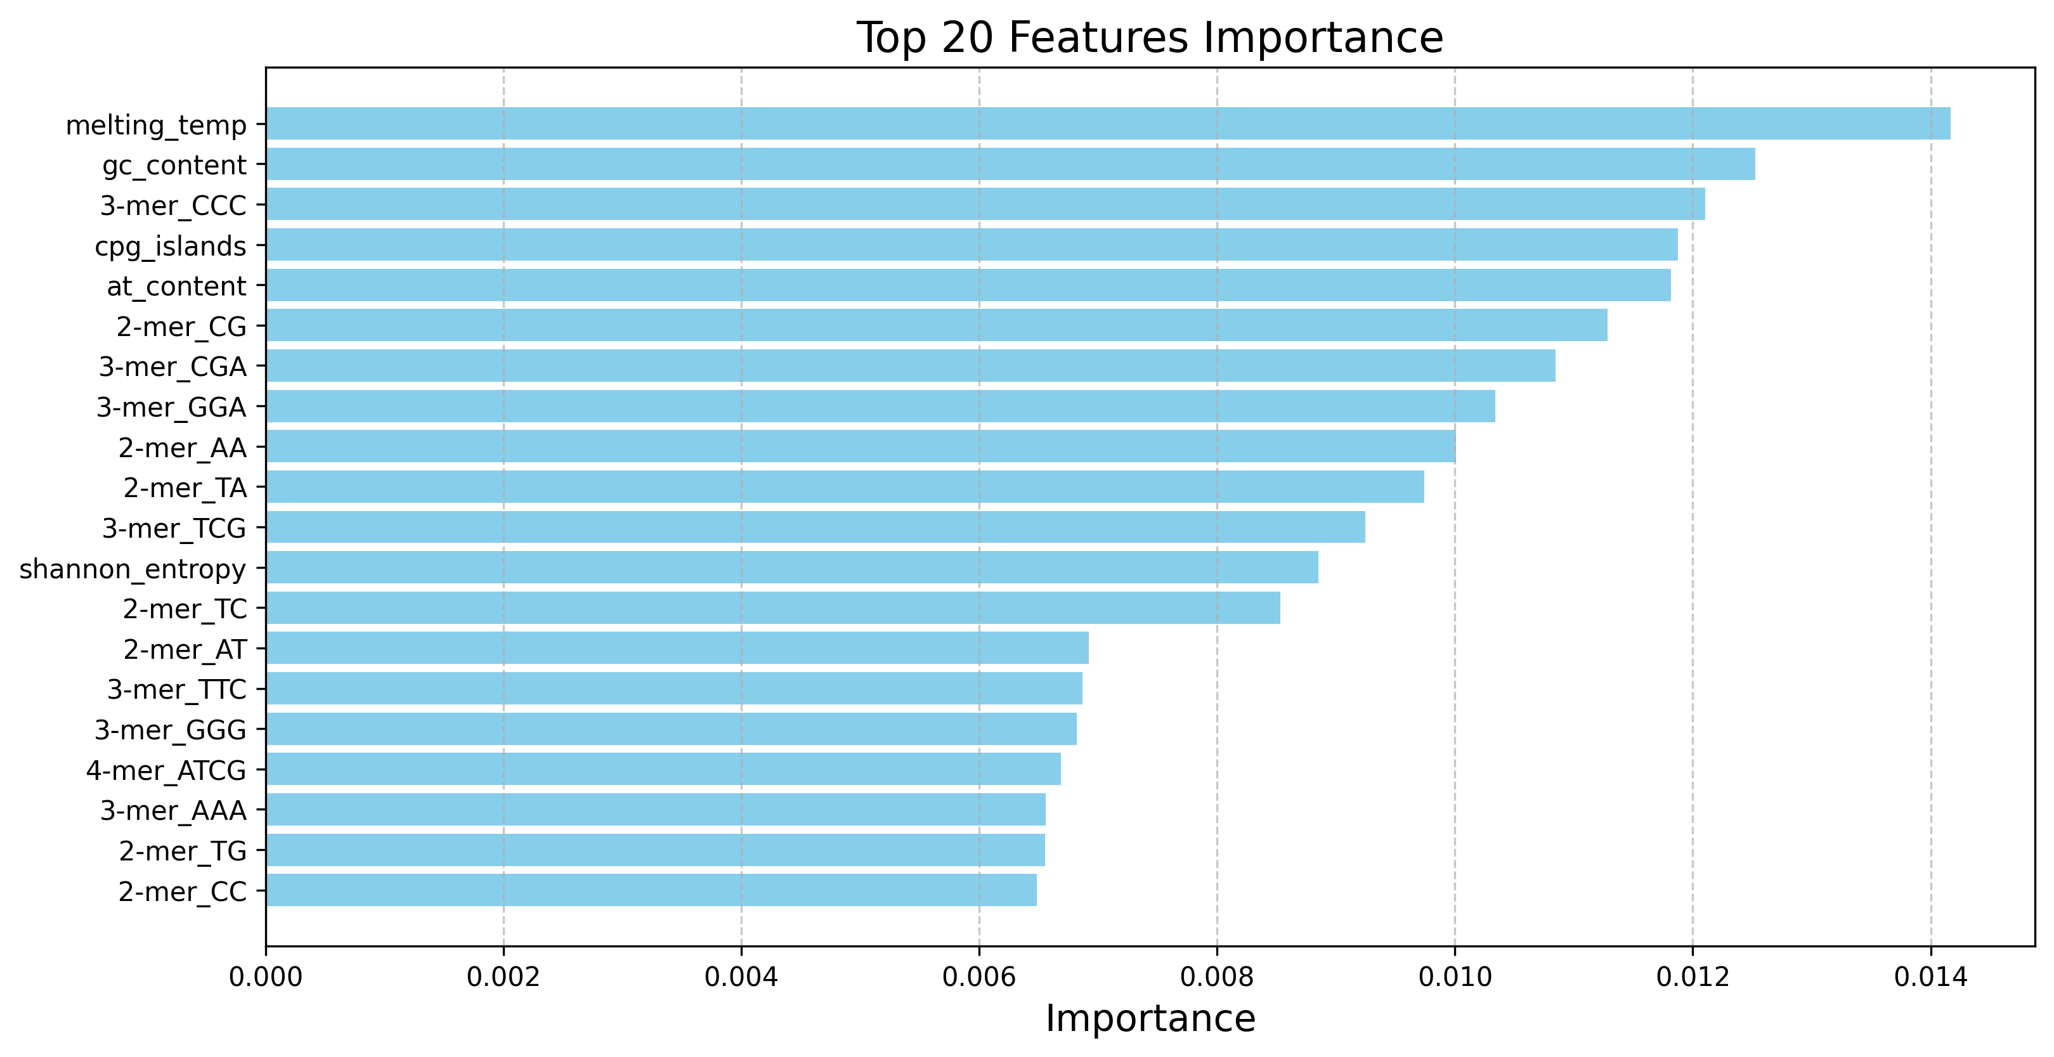
Feature Importance Analysis

Slide 14
Model Evaluation and Metrics
Accuracy: Percentage of correctly classified sequences.
Precision and Recall: Precision to minimize false positives and recall to minimize false negatives, are crucial for pathogenic detection.
F1-Score: Harmonic mean of precision and recall, particularly useful given the binary nature of the problem.
Evaluation Metrics
The performance of ML, DL, and GNNs is compared to identify the most effective model type for pathogen detection, offering a comprehensive view of which algorithm best suits this binary classification problem.
Comparison
Across Models

Slide 15
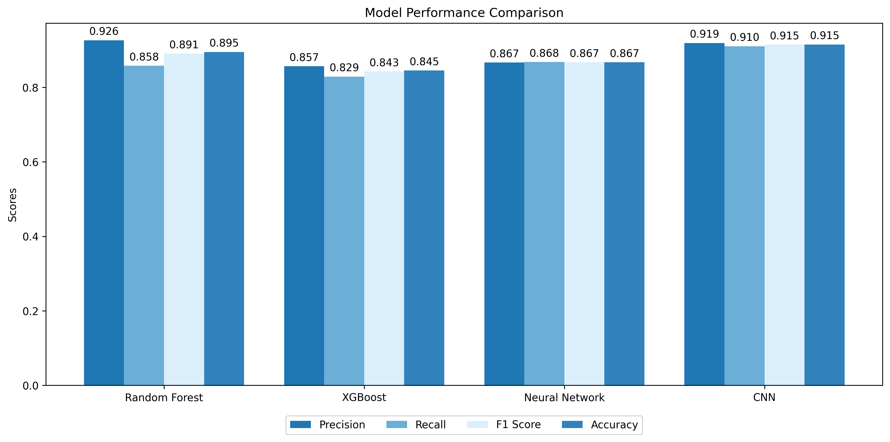
Results
To generate these results we use 2500055 viral sequences and 407 features.

Slide 16
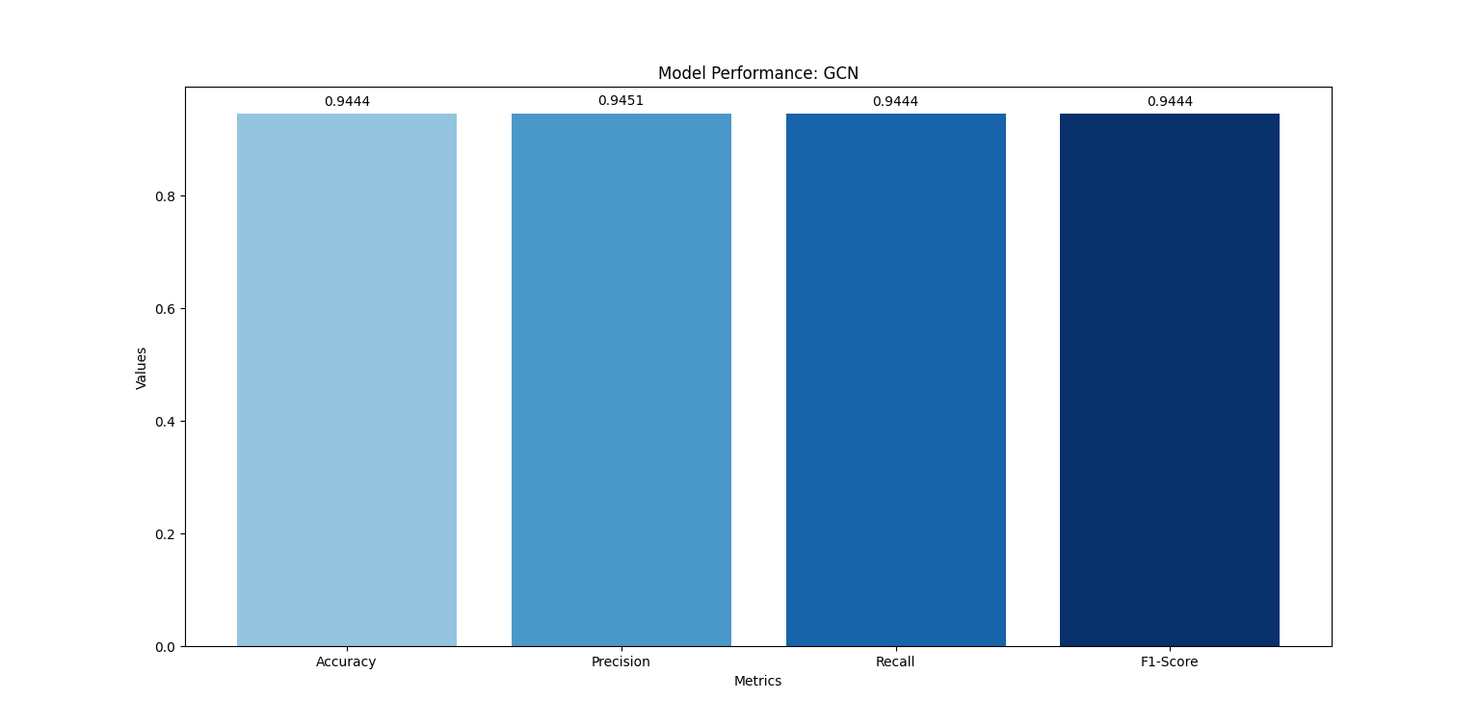
Results
To generate these results we use 20,000 viral sequences and 407 features.

Slide 17
SuGGESTIONS FROm Progess Update-1
Suggestions
How simulated dataset is better? How are they generating it?
We have added features.
What new features can we include?
We have added features.
Add CNN model to benchmarks

Slide 18
Next Steps
GNNs
Run GCN on all the data.

Slide 19
Conclusion
This project utilizes simulated Next-Generation Sequencing (NGS) data to develop predictive models for classifying viral sequences into pathogenic and nonpathogenic categories.
Modeling Techniques: Incorporating a range of methodologies, including Machine Learning (ML), Deep Learning (DL), and graph-based models, the project effectively leverages the strengths of each approach to enhance classification accuracy.
Feature Engineering: By meticulously engineering and selecting key sequence features, the project ensures that the models are trained on the most informative data, facilitating more precise predictions.
This project aims to enhance real-time detection and classification of novel pathogens, with significant public health implications for outbreak management and global preparedness.

Slide 20

Thankyou

